Slide 1
Software Design Patterns
SJC Institue of technology

Slide 2
What is Design Pattern?
Design patterns are standard solutions to common problems in software design. They provide a template or blueprint that developers can follow to address recurring design challenges, promoting best practices and improving code maintainability, flexibility, and scalability.
In software architecture, design patterns are reusable solutions to common problems in software design. While there are many design patterns, they can generally be categorized into three main types:

Slide 3
Type of Design Patterns
Creational Patterns
Structural Patterns
Behavioral Patterns

Slide 4
1. Creational Patterns
These patterns deal with object creation mechanisms, optimizing the process of creating objects.
There are 4 Types:
Singleton: Ensures a class has only one instance and provides a global point of access. Use it when you need to control access to shared resources.
Factory Method: Defines an interface for creating an object but allows subclasses to alter the type of objects that will be created. Use it when a class cannot anticipate the type of objects it needs to create.
Abstract Factory: Provides an interface for creating families of related or dependent objects without specifying their concrete classes. Use it when the system needs to be indepenindependent of how its objects are created.

Slide 5
1. Creational Patterns(continued)
5. Builder Pattern: The Builder pattern separates the construction of a complex object from its representation. This allows the same construction process to create different representations.

Slide 6
2. Structural Patterns
These patterns focus on how objects and classes are composed to form larger structures.
There are 4 types:
Adapter: Allows incompatible interfaces to work together. Use it when you want to use an existing class and its interface does not match your requirements.
Decorator: Adds new functionality to an object dynamically. Use it when you need to extend the behavior of objects without modifying their structure.
Facade: Provides a simplified interface to a complex subsystem. Use it when you want to hide the complexities of a system and provide a simpler interface.

Slide 7
2. Structural Patterns(continued)
5. Proxy Pattern: The Proxy pattern provides a surrogate or placeholder for another object to control access to it. This can be useful for various purposes, such as lazy initialization, access control, or logging.

Slide 8
3. Behavioral Patterns
These patterns deal with object interaction and responsibility.
There are 4 types:
Observer: Defines a one-to-many dependency between objects so that when one object changes state, all its dependents are notified. Use it when you have a scenario where multiple objects need to be informed about changes in another object.
Strategy: Defines a family of algorithms, encapsulates each one, and makes them interchangeable. Use it when you want to choose an algorithm at runtime.
Command: Encapsulates a request as an object, thereby allowing for parameterization of clients with queues, requests, and operations. Use it when you want to parameterize objects with operations.

Slide 9
3. Behavioral Patterns(continued)
4. Template Method Pattern: The Template Method pattern defines the skeleton of an algorithm in a method, deferring some steps to subclasses. It lets subclasses redefine certain steps of an algorithm without changing its structure.
5. Mediator

Slide 10
Singleton Design Pattern(Creational Design Pattern)
Singleton mean: we create single instance(object) for a particular class. Here we need to ensure no other instance(object) are created for that respective class.
USE CASE:
1. DB Creation: In project, we need only one db connect for all the modules of your project.
2.UT(unit test) Manager: a single manager file handle to run all UT’s at a time.
3. Logger manager: Instead of showing logs in different places, we can mange to show all logs in single place in our project

Slide 11
Singleton: Case Study
Q.Design and Implement a Logger class ensuring a single instance throughout the application?

Slide 12
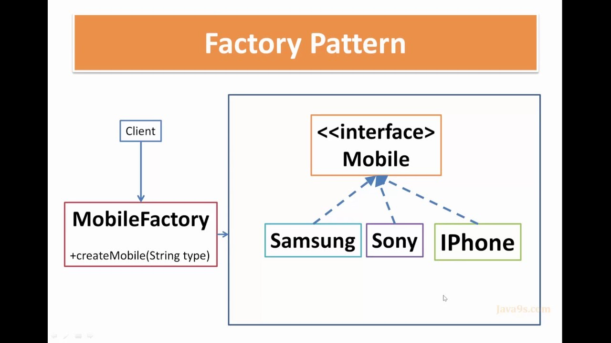
Factory Design Pattern
the Factory Design Pattern encapsulates the creation logic of different shape objects within the ShapeFactory.

Slide 13
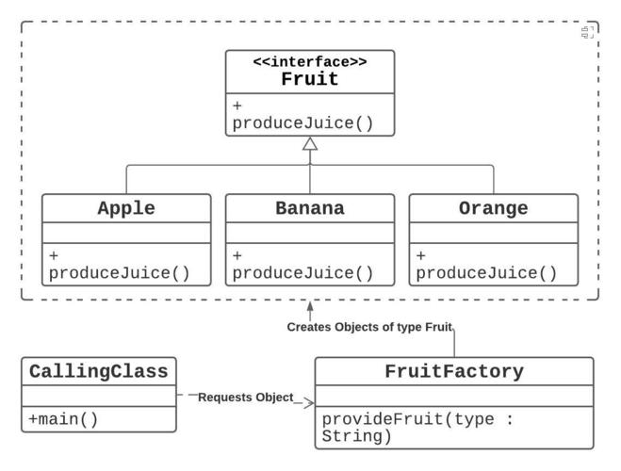
Factory Design Pattern

Slide 14
Factory Design Pattern: Case Study
Q. Design and implement ShapeFactory class that generates different types of Shape objects (Circle, Square, Rectangle) based on input parameters using Factory Design Pattern.

Slide 15
Abstract Factory Design Pattern
The Abstract Factory Pattern, which allows the creation of families of related or dependent objects (in this case, shoes and clothes) without specifying their concrete classes.

Slide 16
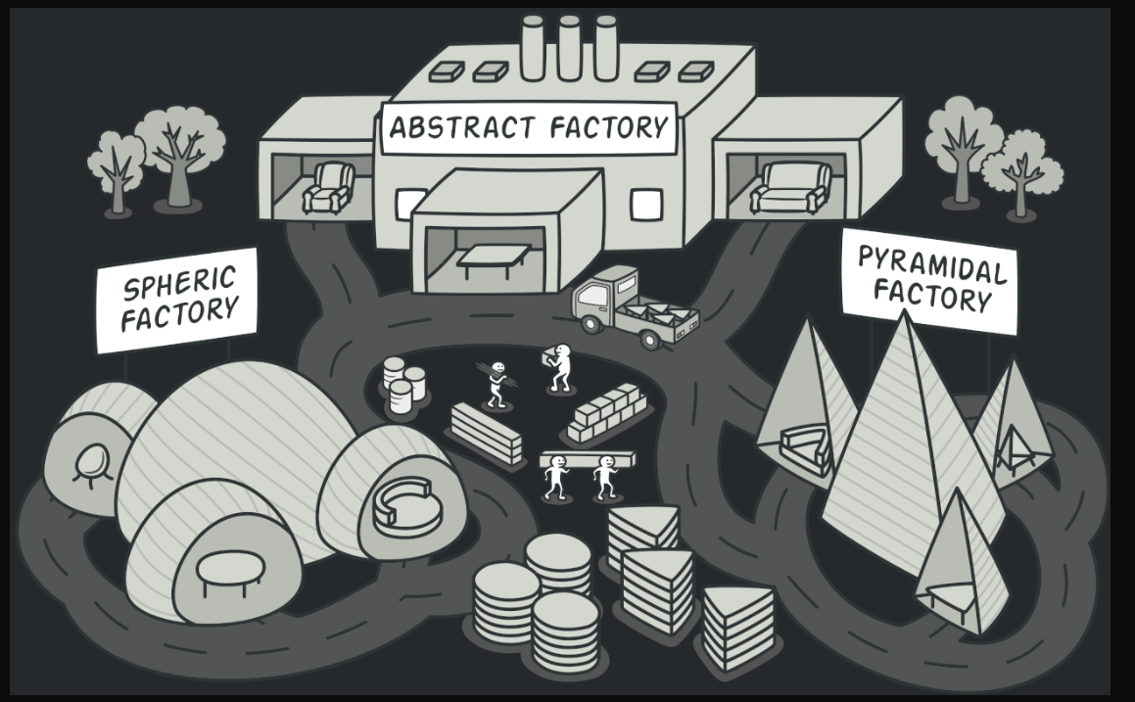
Abstract Factory Design Pattern
The Abstract Factory Pattern, which allows the creation of families of related or dependent objects (in this case, shoes and clothes) without specifying their concrete classes.

Slide 17
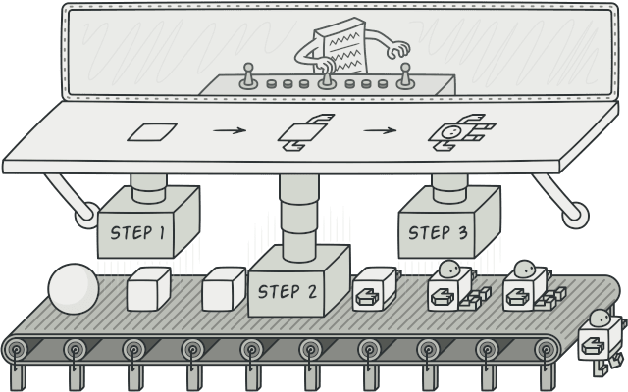
Builder Design Pattern
The Builder Design Pattern is a creational design pattern that is used to construct a complex object in a flexible and step-by-step manner.

Slide 18
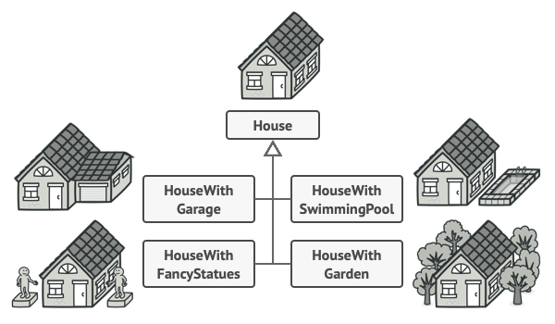
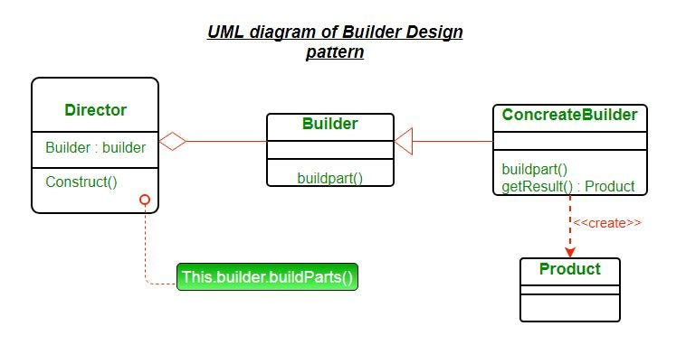
Builder Design Pattern
the Builder Pattern allows for the creation of different representations of a complex object (House) by using specific builders. The use of the Director class simplifies the process of constructing the object, encapsulating the construction logic away from the client code.

Slide 19
Decorator Design Pattern
the Decorator Pattern allows for the dynamic addition of functionalities to an object without modifying its structure.
the Decorator Pattern allows for the dynamic addition of functionalities (in this case, additional ingredients) to an object (coffee) without modifying its structure.

Slide 20
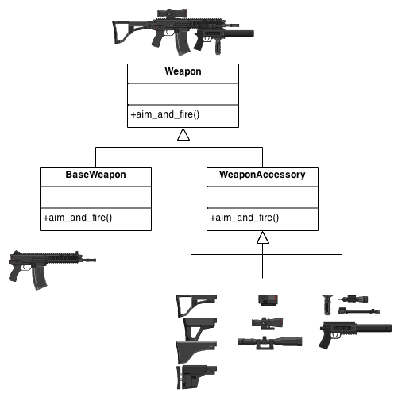
Decorator Design Pattern

Slide 21
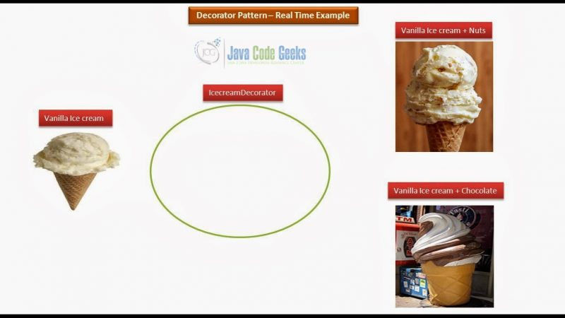
Decorator Design Pattern

Slide 22
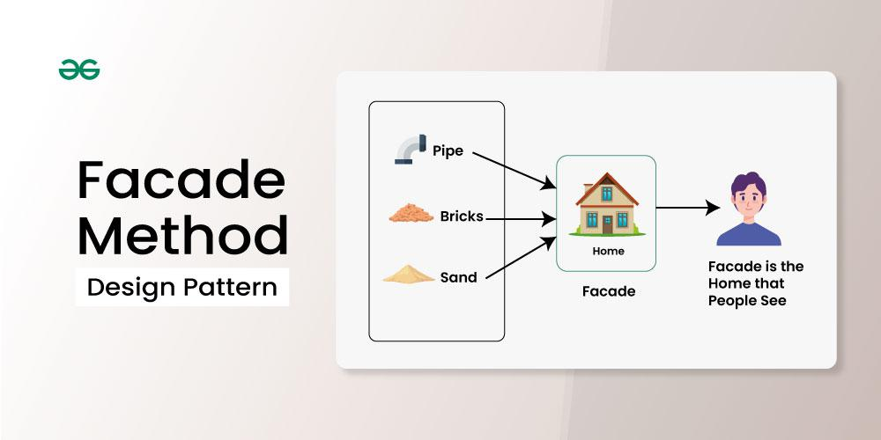
Façade Design Pattern
The Facade Pattern simplifies the interface to a complex system by providing a single class that manages interactions between the system components.

Slide 23
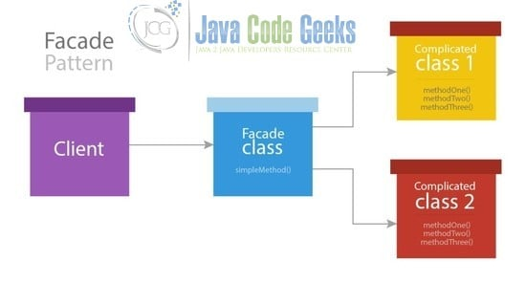
Façade Design Pattern

Slide 24
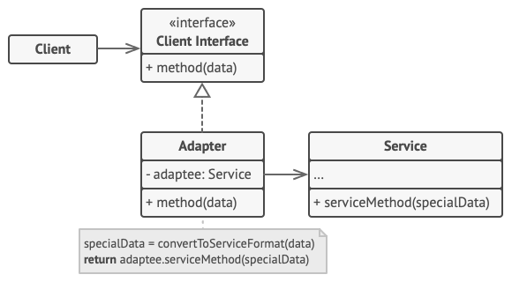
Adapter Design Pattern
The Adapter design pattern is a structural pattern that allows the interface of an existing class to be used as another interface.
“The Adapter Design pattern allows incompatible interfaces to work together by acting as a bridge between two system. It converts one interface into another that the client expects, enabling interaction between classes that otherwise couldn’t collaborate.”

Slide 25
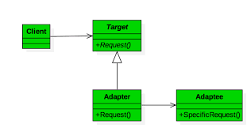
Adapter Design Pattern
The Adapter design pattern is a structural pattern that allows the interface of an existing class to be used as another interface.

Slide 26
Observer Design Pattern
The Observer Design Pattern is useful when you want to create a subscription model where multiple objects (observers) are notified about changes in another object (subject).

Slide 27
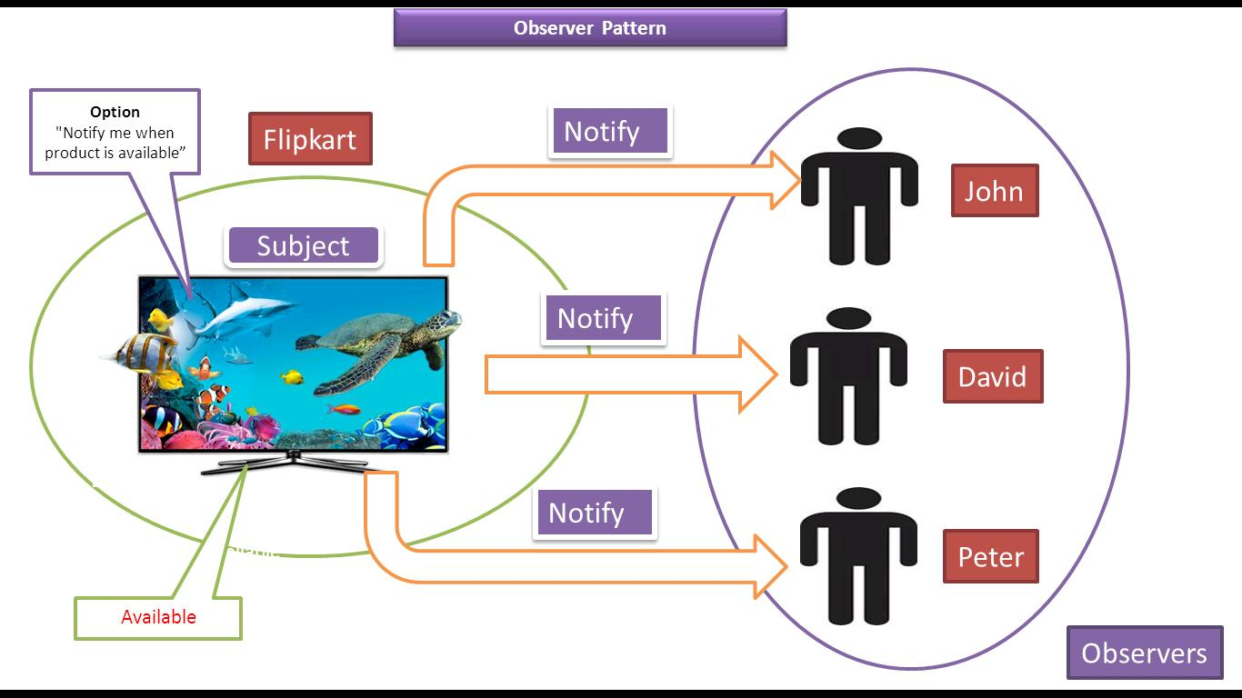
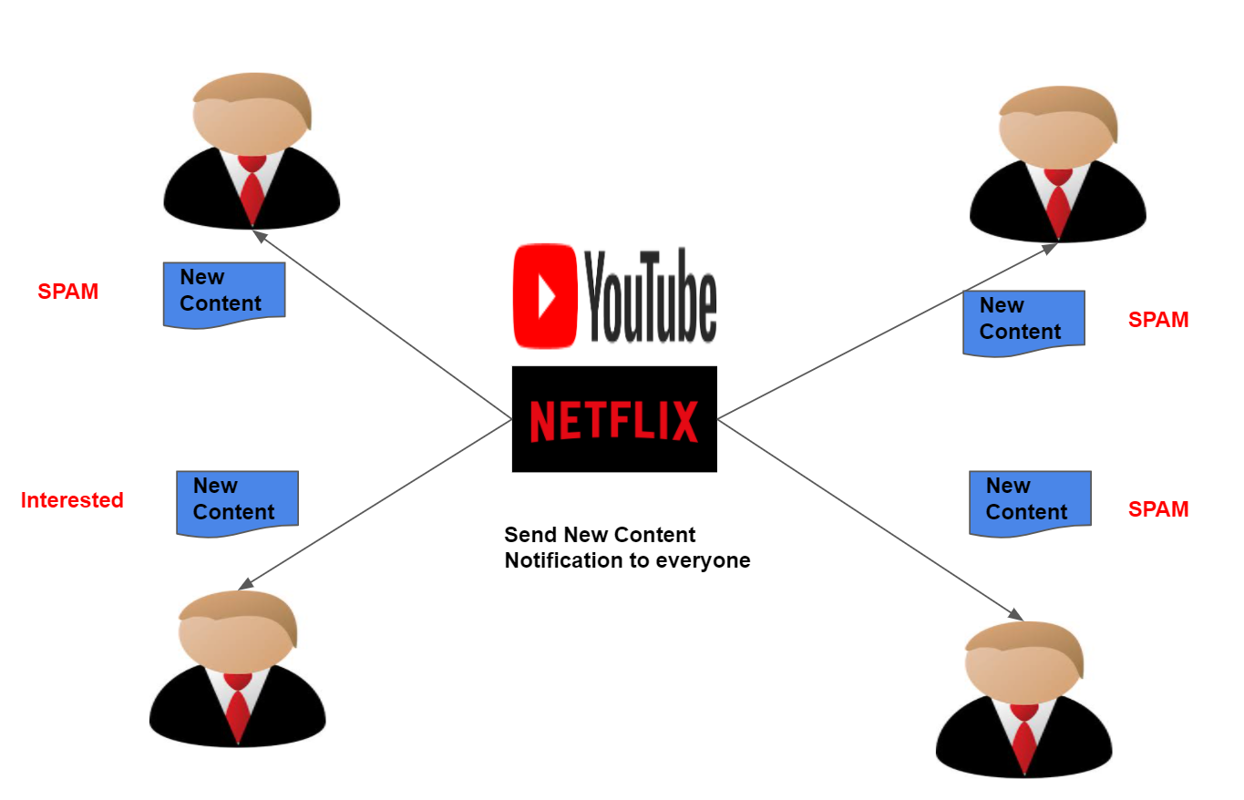
Observer Design Pattern

Slide 28
Template Design Pattern
“The Template Method pattern defines the skeleton of an algorithm in a method, deferring some steps to subclasses. It lets subclasses redefine certain steps of an algorithm without changing its structure.”
**The Template Method Pattern allows you to define a common process (in this case, processing documents) while allowing subclasses to specify the details of certain steps.

Slide 29
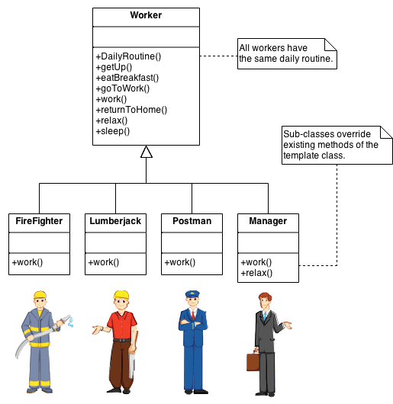
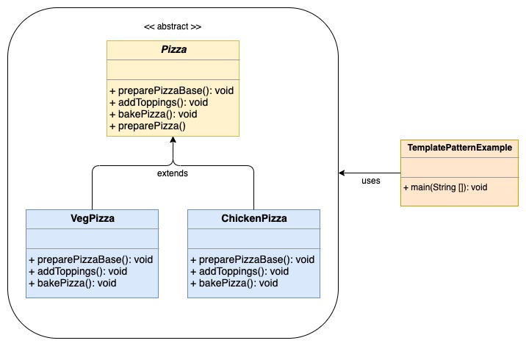
Template Design Pattern

Slide 30
Observer Design Pattern
“The Observer Design Pattern is useful when you want to create a subscription model where multiple objects (observers) are notified about changes in another object (subject).”
Example: YouTube, E-com, Spotify, Netflix etc.. Notify the subscribers if any latest content available.
Real-Time: WeatherStation, here we notify the temperature updates to all the subscribers
Summary
• The Observer Design Pattern is useful when you want to create a subscription model where multiple objects (observers) are notified about changes in another object (subject).
• In this implementation, the WeatherStation serves as the subject that tracks its state (temperature) and notifies all registered DisplayDevice instances whenever the temperature changes.

Slide 31
Proxy Design Pattern
The Proxy class controls access to the RealResource instance. It checks the user's permissions before allowing access to the resource.
It act as gatekeeper
Ex: Sharepoint, repo, tools access links in company
Summary :
• The Proxy Design Pattern is useful when you want to provide a surrogate or placeholder for another object to control access to it. • In this implementation, the Proxy checks the user's permissions before allowing access to the RealResource, effectively acting as a gatekeeper.

Slide 32
Mediator Pattern
The Mediator Design Pattern belongs to the Behavioral Design Patterns category.
“The Mediator Design Pattern centralizes communication between multiple objects by having them interact through a mediator, rather than directly with each other. This reduces depencies and simplifies complex object interactions.”
The Mediator pattern defines an object (mediator) that encapsulates how a set of objects interact with each other, reducing direct dependencies between them.
Real-World Example:
In a chat application, participants (users) do not communicate directly with each other. Instead, a "ChatRoom" (mediator) facilitates communication between users. This way, users are not aware of the other participants' details, and the chat room controls the message flow.

Slide 33
Mediator Pattern
Q. Design and Implement a Mediator pattern to manage communication between a set of objects (e.g., chat room with multiple participants).?
Summary :
The Mediator Design Pattern allows for the decoupling of components by using a mediator to facilitate communication between them.
In this example, the ChatRoom class serves as the mediator that manages the interaction between Participant instances, making the system more organized and reducing dependencies among the components.

